Slide 1
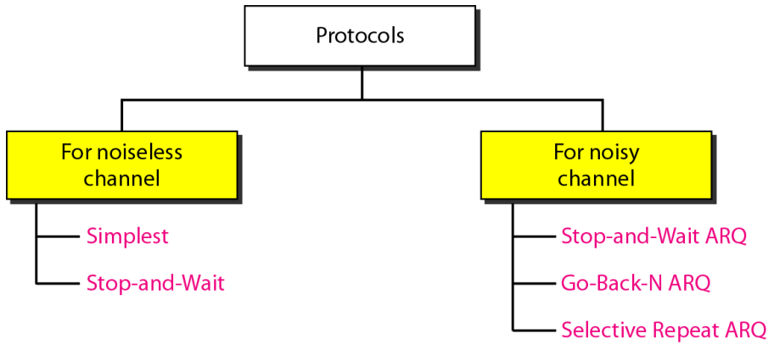
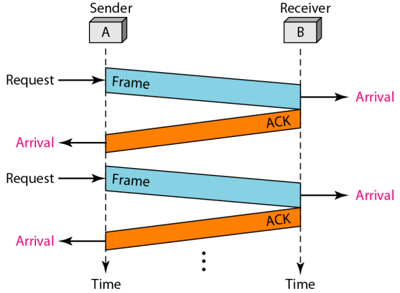

Error Control in Communication

Slide 2
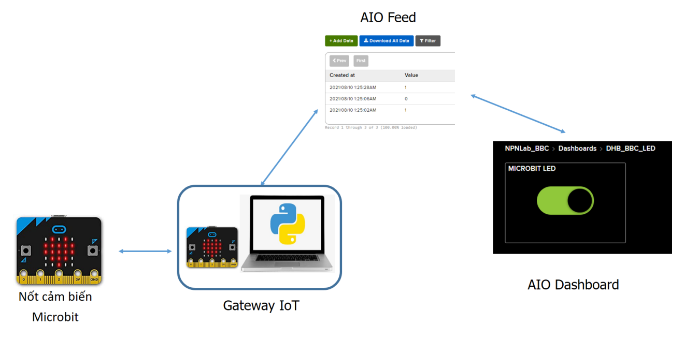
System Architecture
Sensor Nodes

Slide 3
Communication Protocol
The combination of framing, flow control, and error control to achieve the delivery of data from one node to another.
The protocols are normally implemented in software by using one of the common programming languages.

Slide 4
Classification of Protocols

Slide 5
NOISELESS CHANNELS
No frames are lost, duplicated, or corrupted
Simplest Protocol – has no flow or error control
Stop-and-Wait Protocol – sender sends one frame, stops until it receives agree from receiver and then sends the next frame

Slide 6
Simplest Protocol
Unidirectional protocol: data frames are traveling in only one direction-from the sender to receiver.
The receiver can immediately handle any frame it receives with a processing time that is small enough to be negligible.
The data link layer of the receiver immediately removes the header from the frame and hands the data packet to network layer, which can also accept the packet immediately.

Slide 7
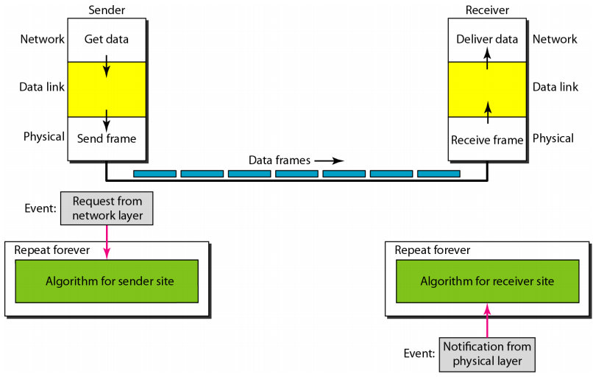
Simplest Protocol Design
message

Slide 8
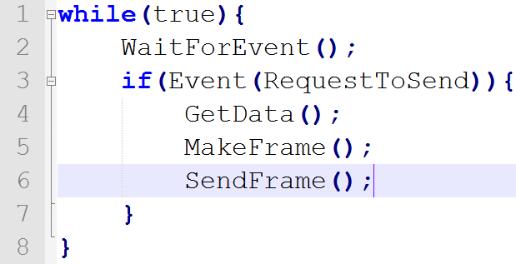
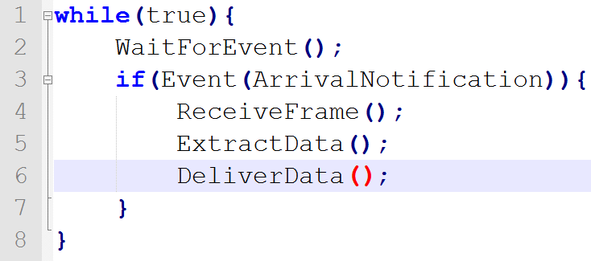
Implementation

Slide 9
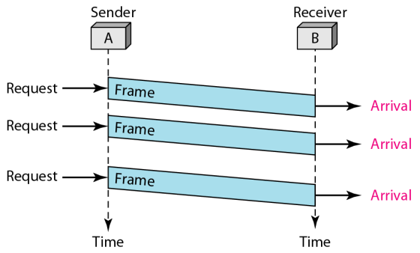
Example
Propagation delay
The sender sends a sequence of frames without even thinking about the receiver
There is no error handler
There is no synchronization (the receiver processing time is slower than the transmission speed)

Slide 10
Stop and Wait Protocol
If data frames arrive at the receiver site faster than they can be processed, the frames must be stored until their use
Normally, the receiver does not have enough storage space, especially if it is receiving data from many sources
The sender sends one frame, stops until it receives agreement the receiver (okay to go ahead), and then sends the next frame
ACK frames (simple tokens of acknowledgment) travel from the other direction

Slide 11
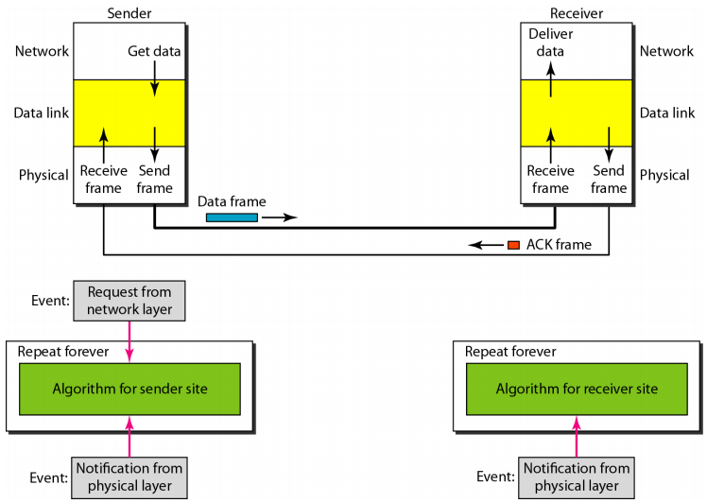
Stop and Wait Protocol Design

Slide 12
Example
The sender sends one frame and waits for feedback from the receiver before sending the next frame
Four events at the Sender and two events at the Receiver

Slide 13
NOISY CHANNELS
Although the Stop-and-Wait Protocol gives us an idea of how to add flow control to its predecessor, noiseless channels are nonexistent.
Stop-and-Wait Automatic Repeat Request(ARQ)
Go-Back-N Automatic Repeat Request
Selective Repeat Automatic Repeat Request

Slide 14
Stop and Wait ARQ Principles
A copy of a frame (sent to the receiver) is kept in the buffer
Retransmitting this frame when the timer expires, meaning that ACK is not received
Sequence numbers are used to index the frames.
The acknowledgment number always announces the sequence number of the next frame expected

Slide 15
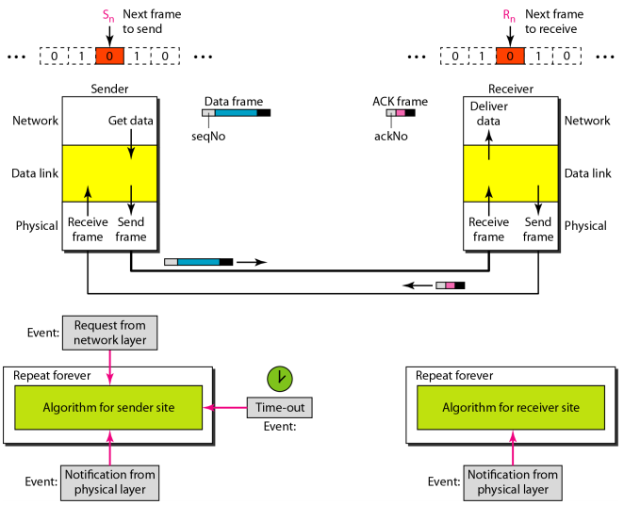
Stop and Wait ARQ Protocol

Slide 16
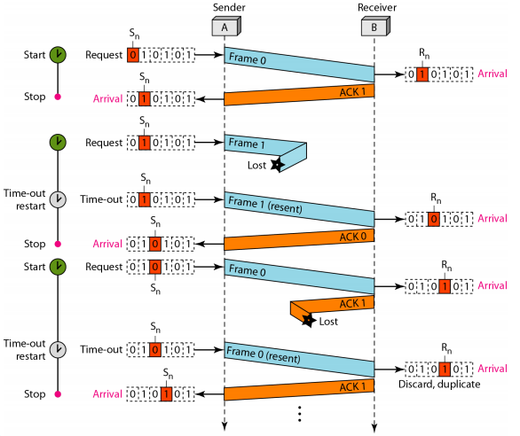
Example
Frame is lost
ACK is lost
Duplicate reception at the receiver

Slide 17
Go-Back-N Automatic Repeat Request
Multiple frames must be in transition while waiting for acknowledgment to maximize the efficiency
Protocol principles:
Several frames are sent before receiving ACKs
A copy of these frames are kept until the ACKs arrive

Slide 18
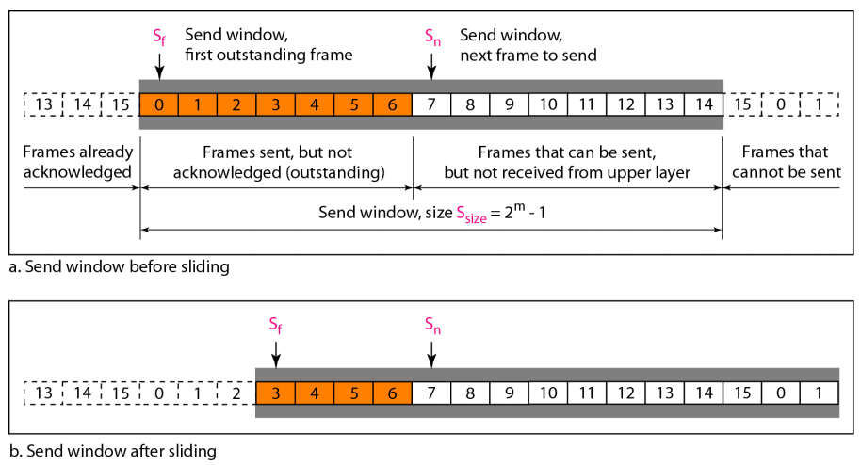
Send Windows for Go Back N (m=4)

Slide 19
Definitions
S_{f}: the sequence number of the first (oldest) outstanding frame
S_{n}: the sequence number that will be assigned to the next frame to be sent.
S_{size}: the size of the window, which is fixed in our protocol.
S_{f} can slide one or more slots when a valid ACK arrives.

Slide 20
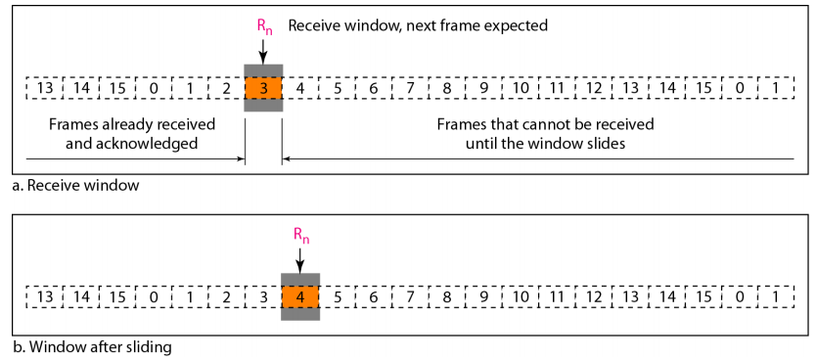
Receive Windows for Go Back N
The window slides one slot when a correct frame has arrived;

Slide 21
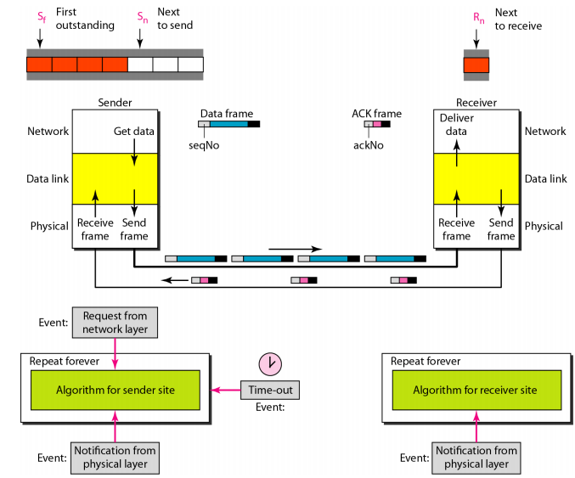
Go Back N Design

Slide 22
Selective Repeat Automatic Repeat Request
In a noisy link a frame has a higher probability of damage, which means the resending of multiple frames. This resending uses up the bandwidth and slows down the transmission
Selective Repeat ARQ: does not resend N frames when just one frame is damaged
It is more efficient for noisy links, but the processing at the receiver is more complex compared to Go Back N

Slide 23
Selective Repeat ARQ
Two windows are used: a send window and a receive window as Go Back N
The size of the sending window is smaller: 2^{m-1}
The received window is the same size as the send window (in Go Back N, the size is only 1).
For example, if m = 4, the sequence numbers go from 0 to 15, but the size of the window is just 8 (it is 15 in the Go-Back-N Protocol). The smaller window size means less efficiency in transmission, but the fact that there are fewer duplicate frames.

Slide 24
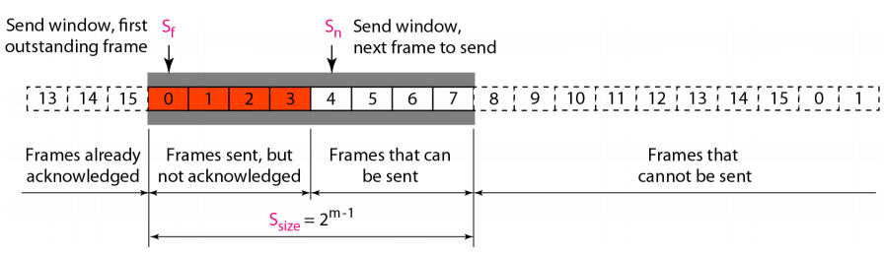
Sending Windows (m=4)

Slide 25
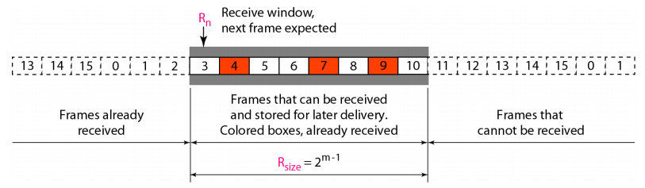
Received Windows (size 2^{m-1})
Many frames can be arrived out of order and be kept until there is a set of in-order frames to be delivered to the network layer
All the frames in the send frame can arrive out of order and be stored until they can be delivered.

Slide 26
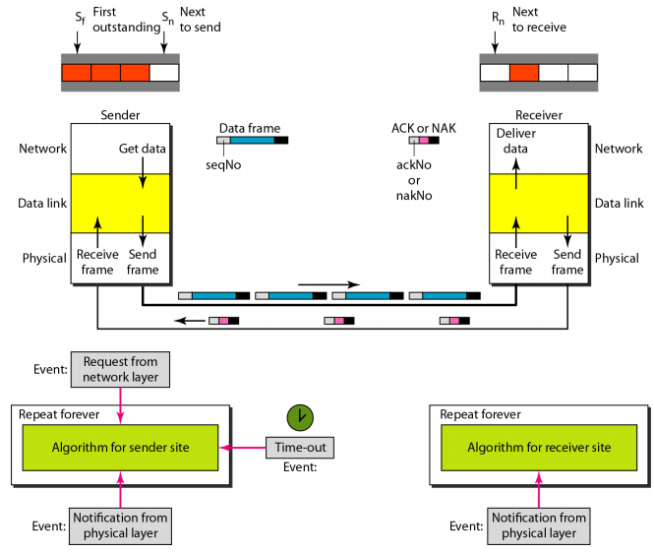
Design of Selective Repeat ARQ

